Slide 1



Slide 2


Waarom?
Onze aanpak.
Hoe was onze werkverdeling?

Slide 3
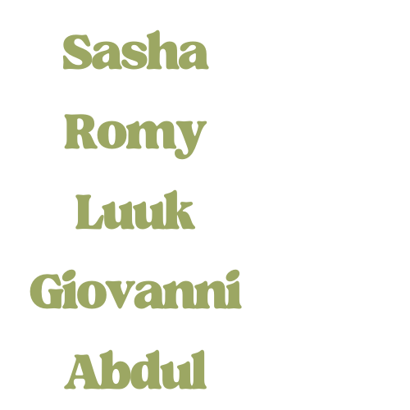
Media
Media

Slide 4

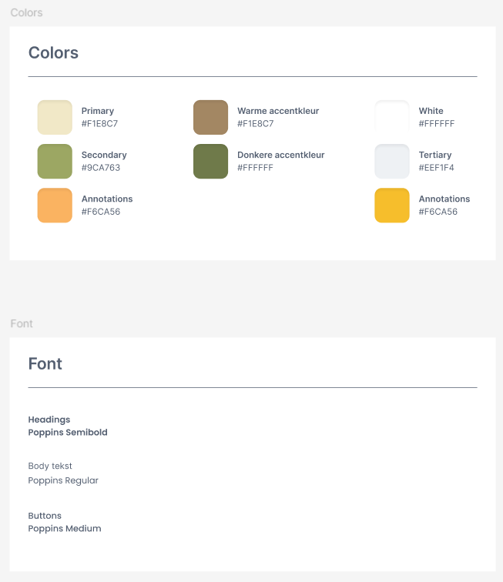
Media

Slide 5




Media

Slide 6
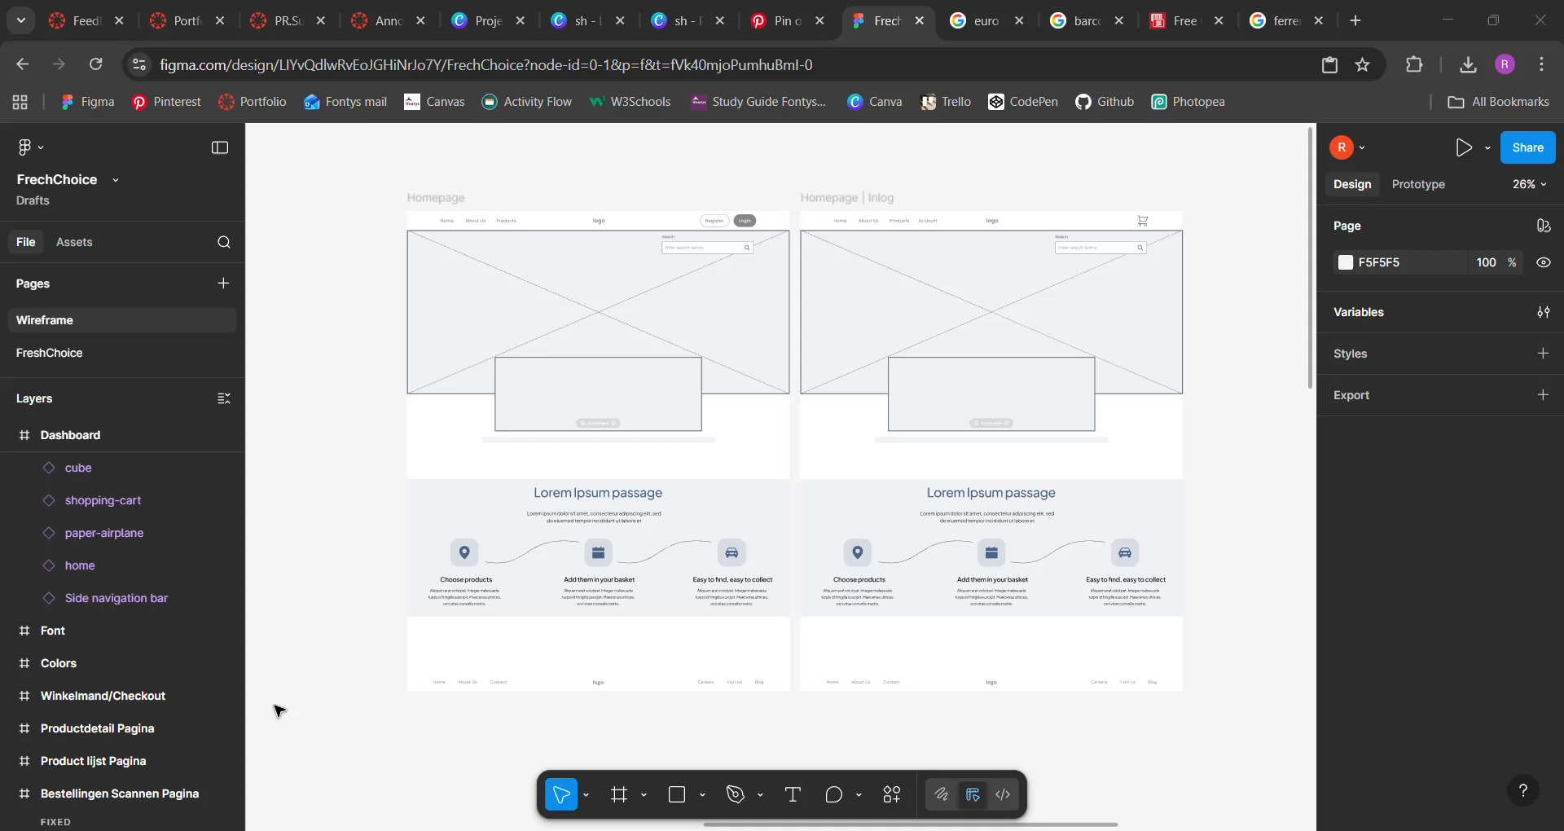
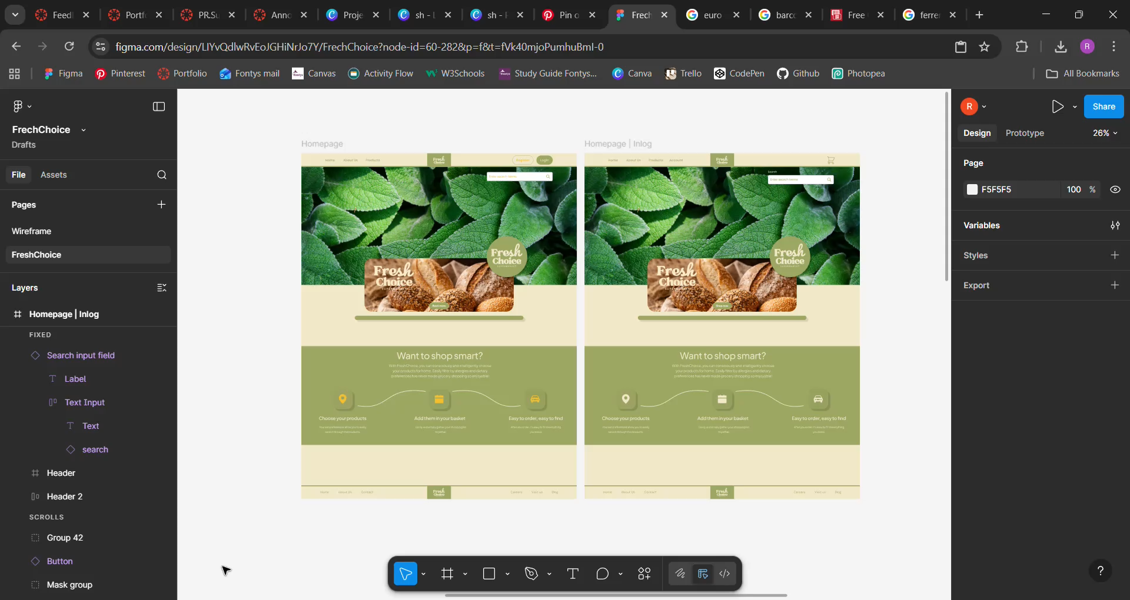
Wireframe
Ontwerp
Media

Slide 7
LO3 & LO4
Media

Slide 8
Software
Software

Slide 9
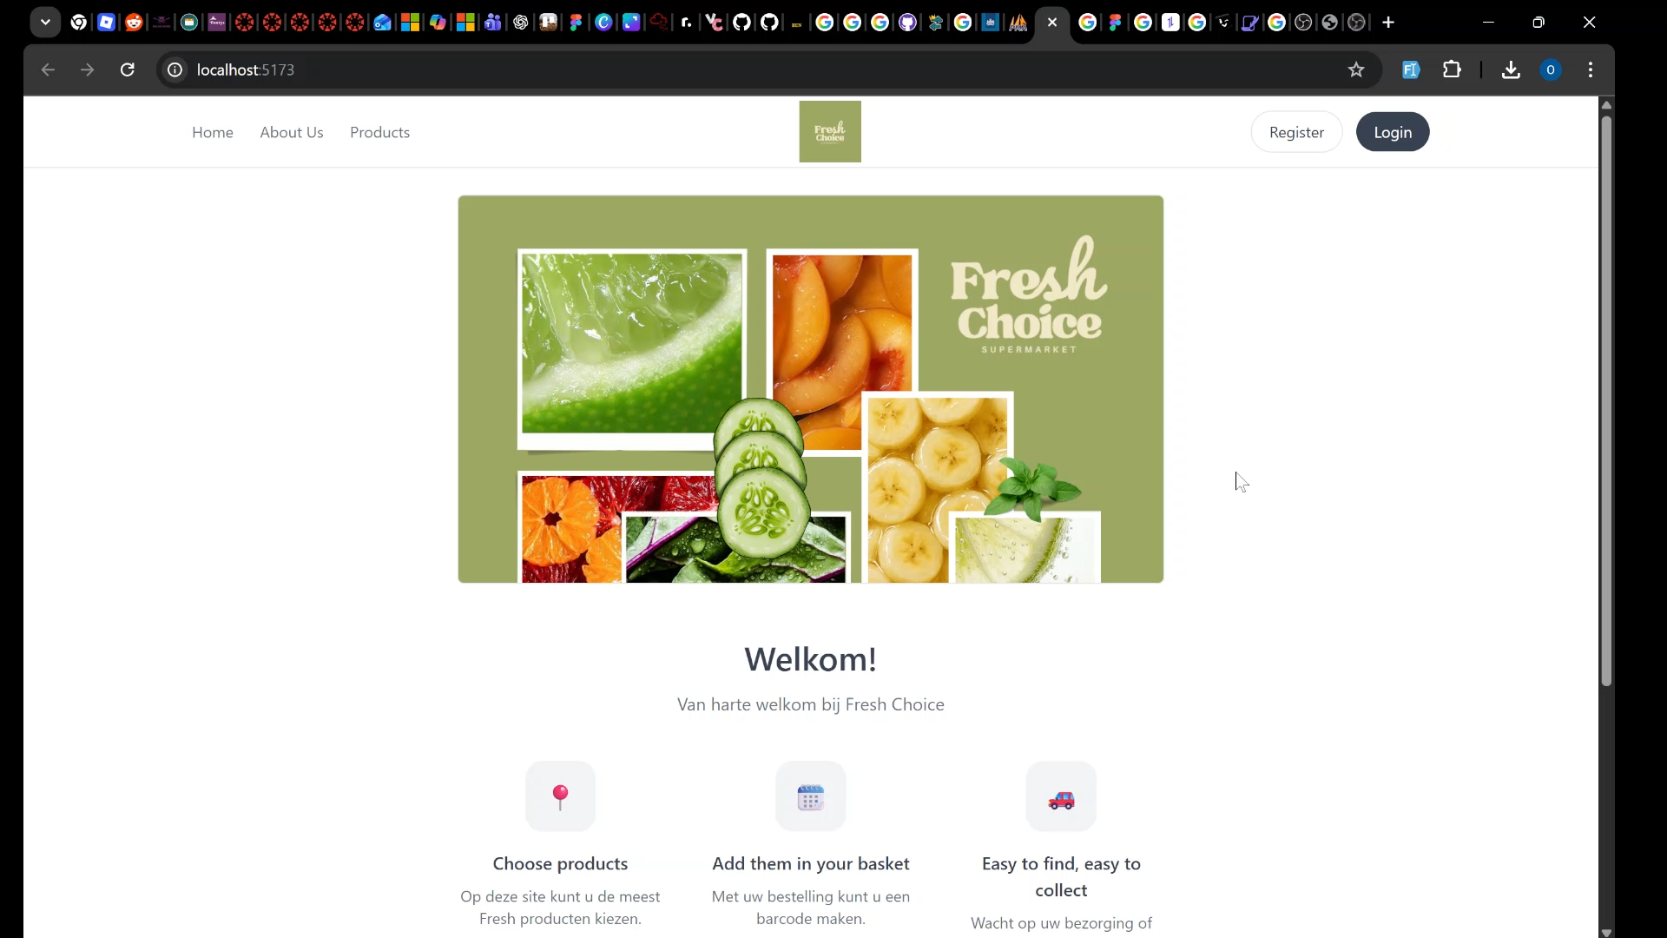
Software

Slide 10
LO3 & LO4
Feedpulse toegepast
Planning
Risico analyse
Software

Slide 11
Software
Software

Slide 12
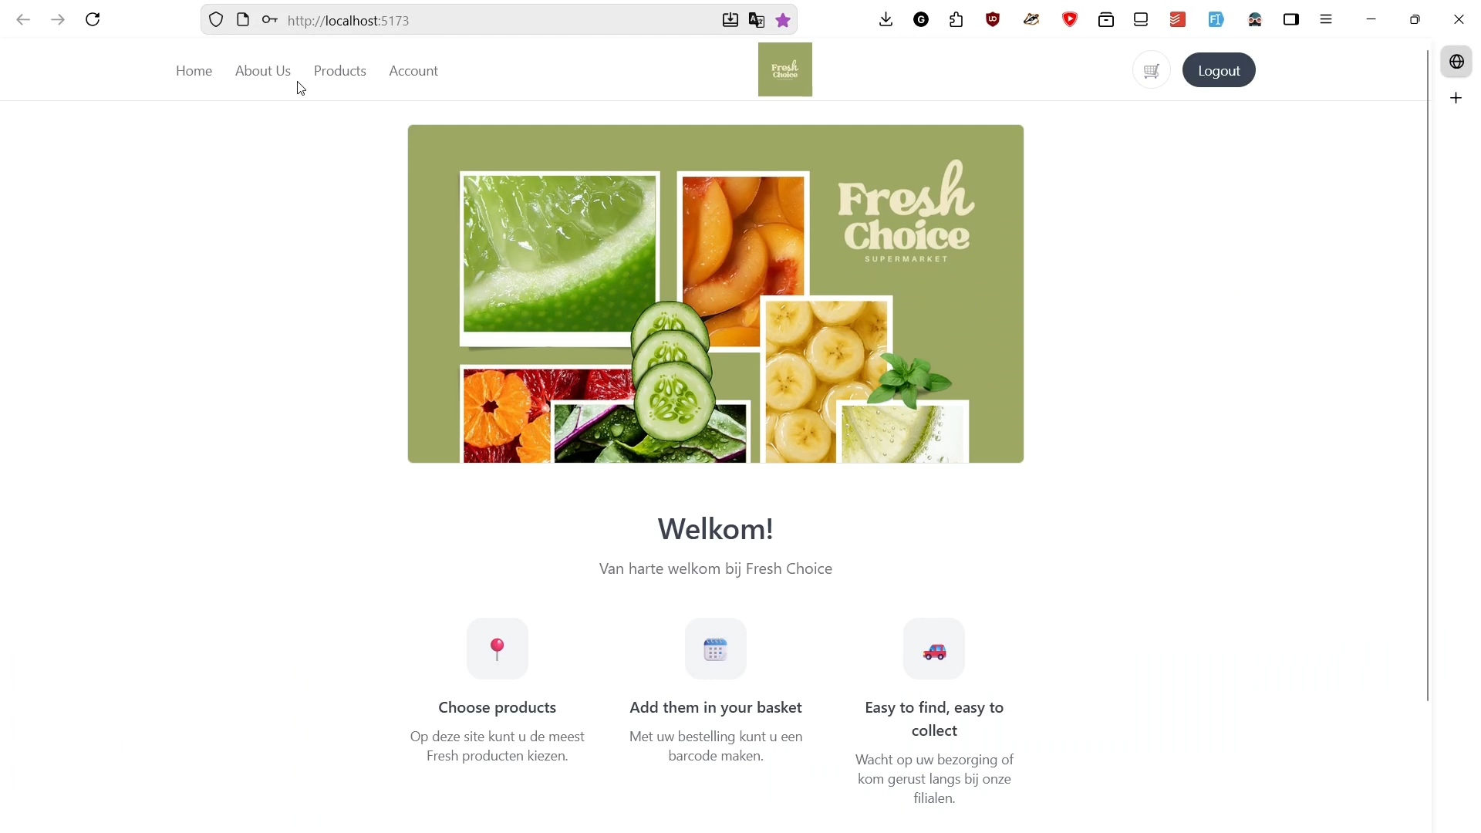
Software

Slide 13
Persoonlijk leiderschap:
Actief feedback gezocht
Project plan
Concrete doelen
Reflectie
Software

Slide 14
Techology
Technology

Slide 15
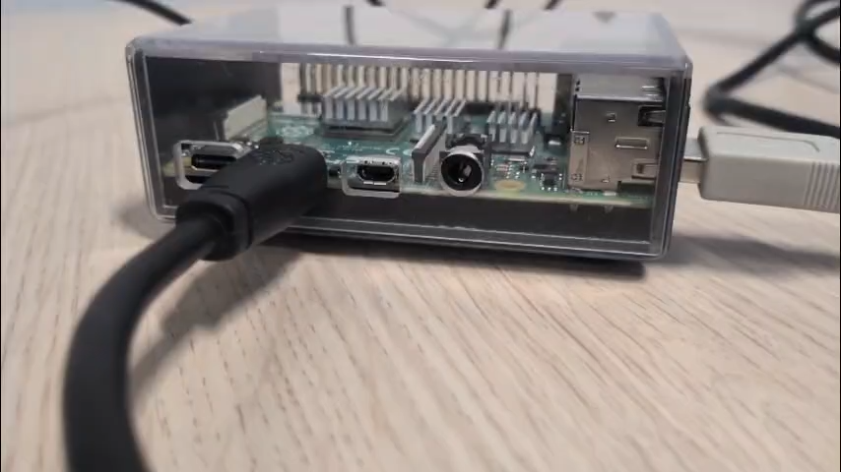
Technology

Slide 16
LO3 & LO4
Technology

Slide 17
Business
Business

Slide 18
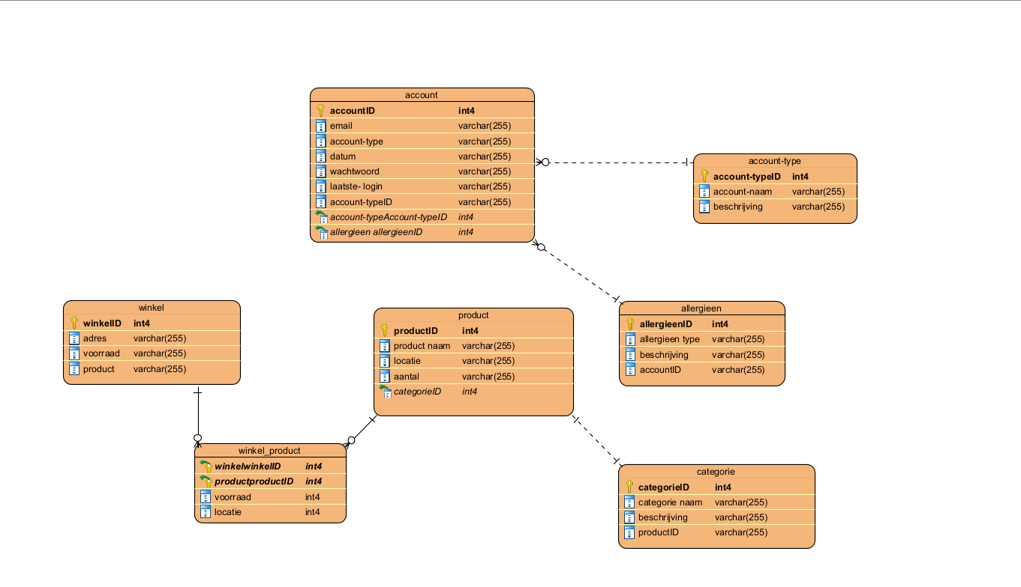
Business

Slide 19
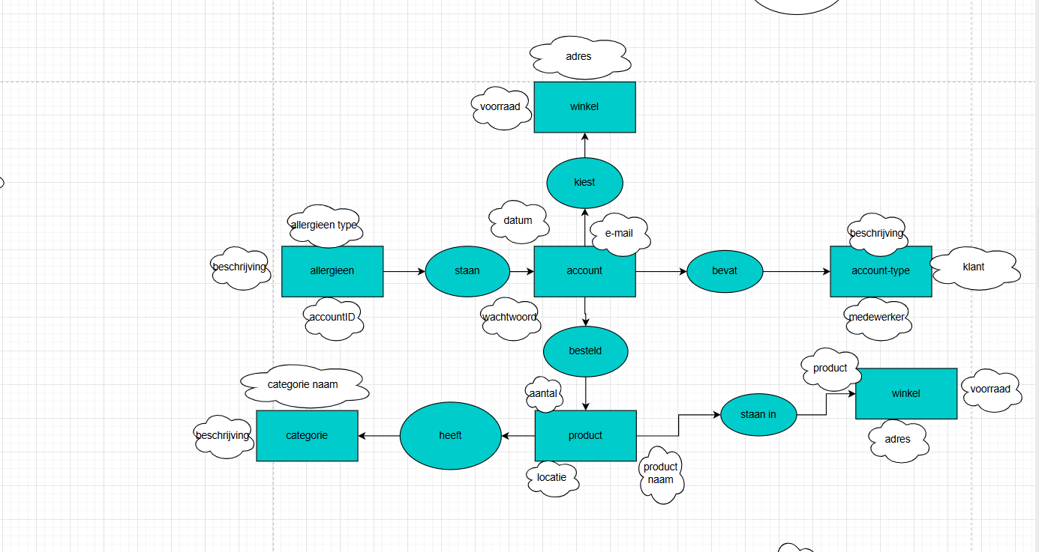
Business

Slide 20
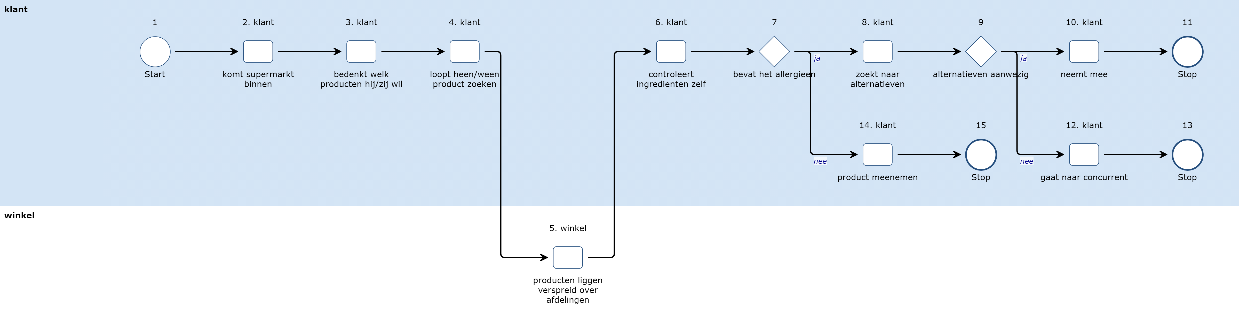
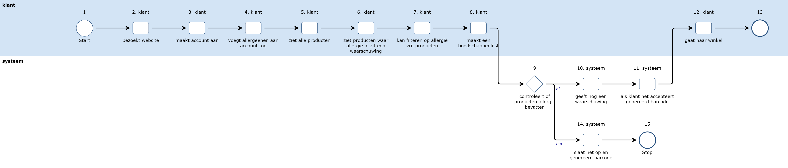
Business

Slide 21
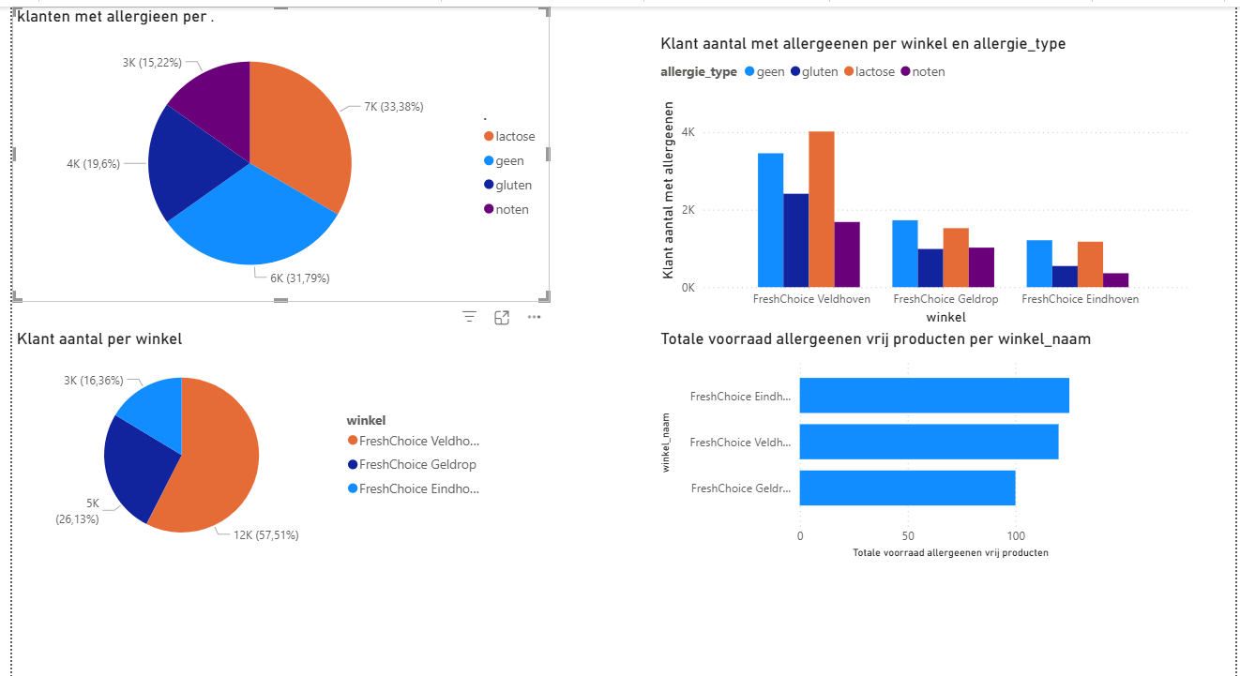
Business

Slide 22
LO3 & LO4
Business

Slide 23


